Slide 1
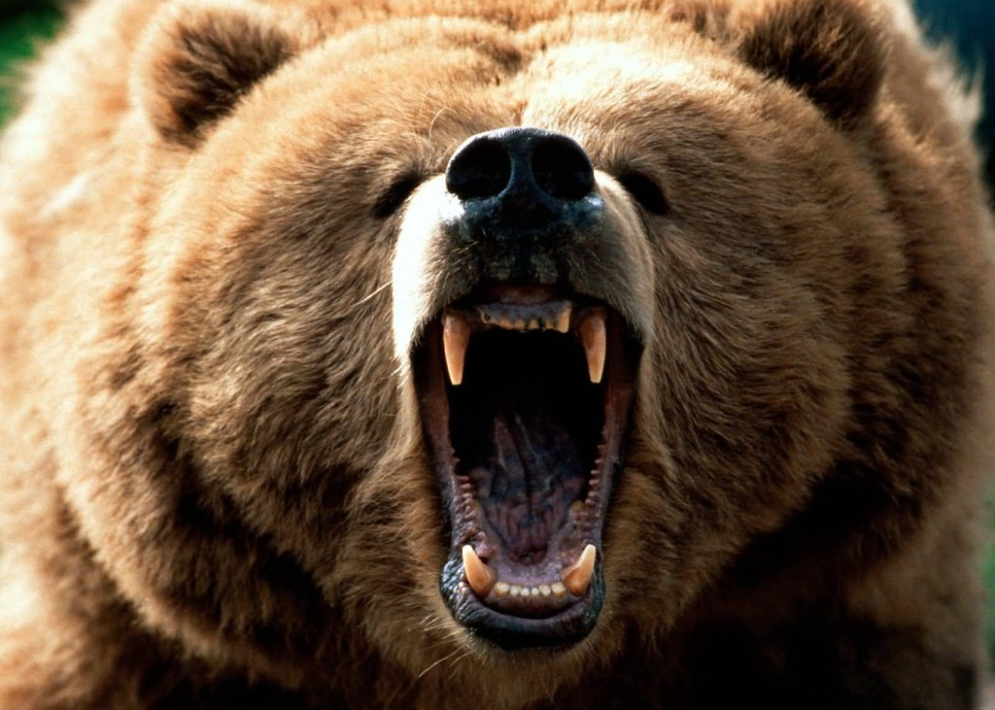

Attack of the Killer Bears
Data Analytics Bootcamp: Project 1
Geoffrey Holland
Karsten Olsen
Sarah Raisian
David Winton

Slide 2
Motivation
We all know bears are dangerous, and you might have an idea of what to do if you see one, but how often do bear deaths occur?
Curiosity about national parks and killer bear statistics
Do bear killings occur only in the wild?
What type of bear is involved?
How old are the victims?
Where do the most bear killings occur?

Slide 3
Data and Questions
Dataset
Name: north_america_bear_killings.csv
Source: Data.World*
Number of Victims: 167
Features: 14
Questions
Who dies from bear killings?
How do they die?
Have deaths decreased over time?
Where do these deaths occur?
*https://data.world/ajsanne/north-america-bear-killings/file/north_america_bear_killings.csv
*Opening Bear Growl: https://www.partnersinrhyme.com/soundfx/bearsounds.shtml
{Name, Age, Gender, Date, Year, Type(Wild or Captive), Location, Description, Type of Bear, Hunter (Boolean), Grizzly (Boolean), Hikers (Boolean), Only One Killed (Boolean)}

Slide 4
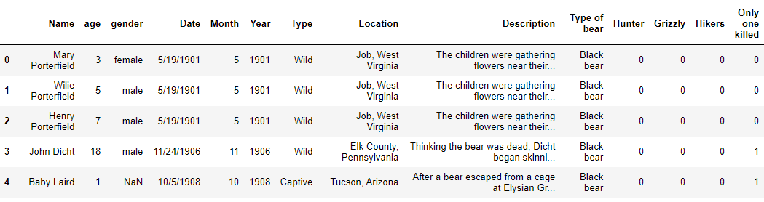
Data

Slide 5
Data Cleanup & Exploration
Victim Age: Dropped Age due to values missing from two entries
Type of Bear: Added Grizzly bear (type of brown bear) into the analysis (Used the boolean feature in the data set)
Location: Filtered deaths by locations with 2+ due to multiple 1 death counts

Slide 6
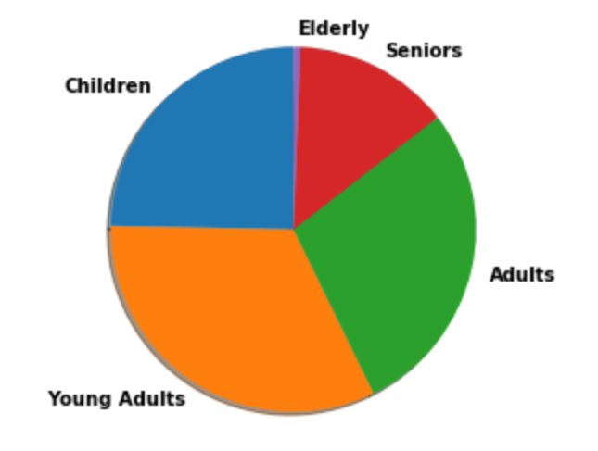
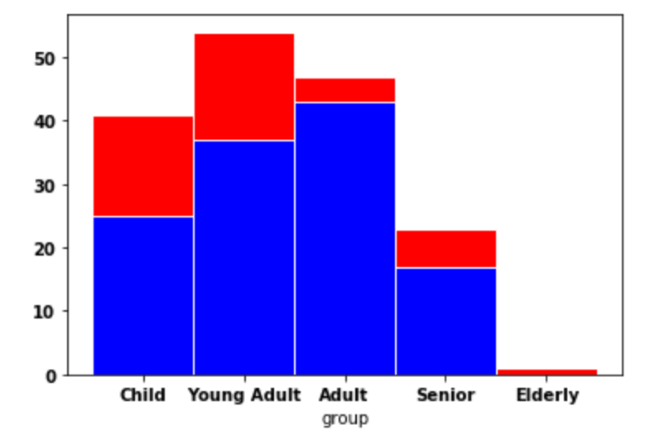
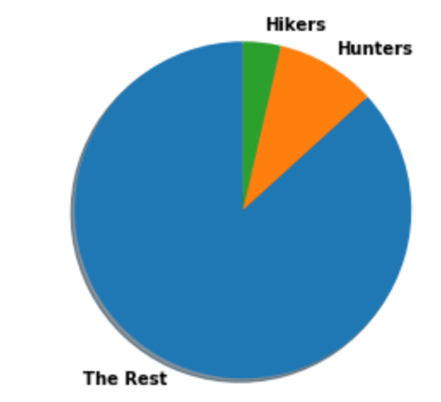
Analysis : Who dies from bear killings?
Age Findings:
Young Adults, in the wild
16 hunters, 6 hikers

Slide 7
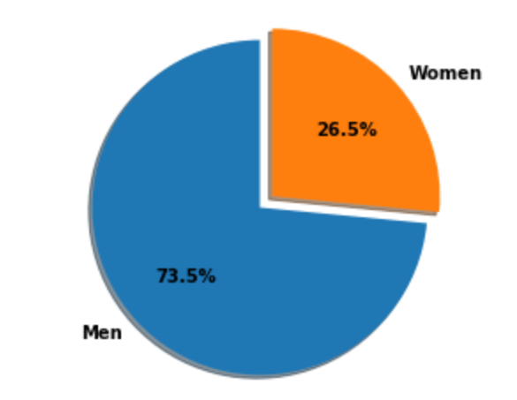
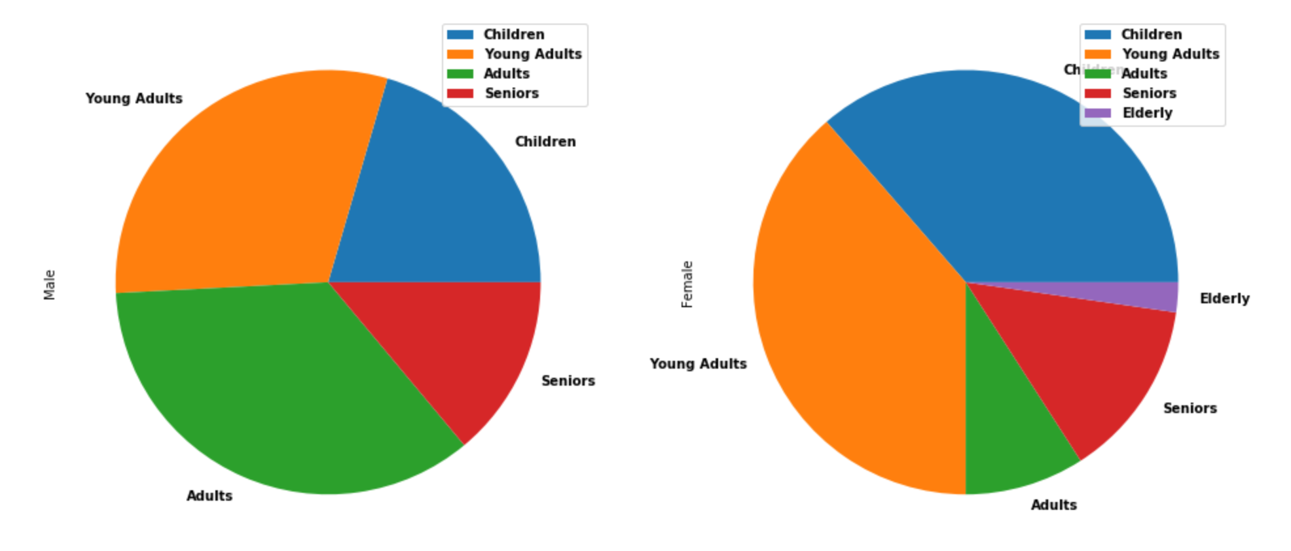
Gender Demographics
Findings:
Young Adults died more often, more specifically men.
Obstacles:
Outside from scrubbing the data this was pretty straight forward. Deciding the best way to visualize the important information without too many colorful and overwhelming graphs was the hard part.

Slide 8
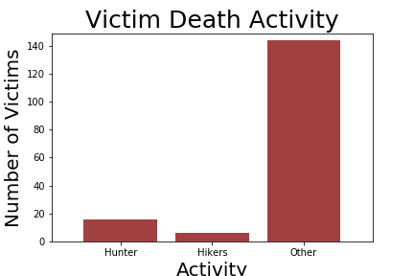
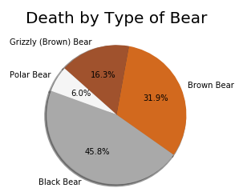
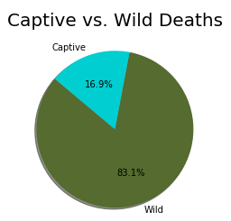
Analysis : How do victims die?
Findings:
Most deaths by Brown bears (including Grizzly)
Most deaths in national parks and wild areas
Most victims killed while doing “Other” *
*“Other” activity could use text mining for better analysis and insight

Slide 9
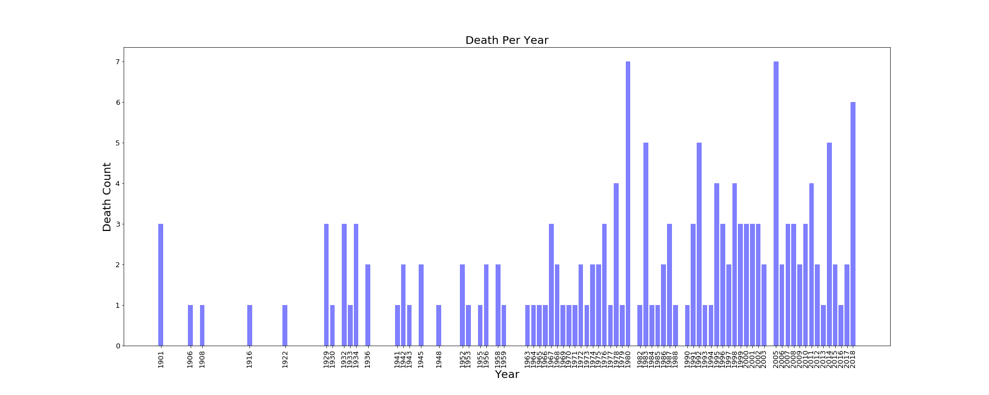
Analysis : How have killings changed across time?
Deaths Increased!

Slide 10
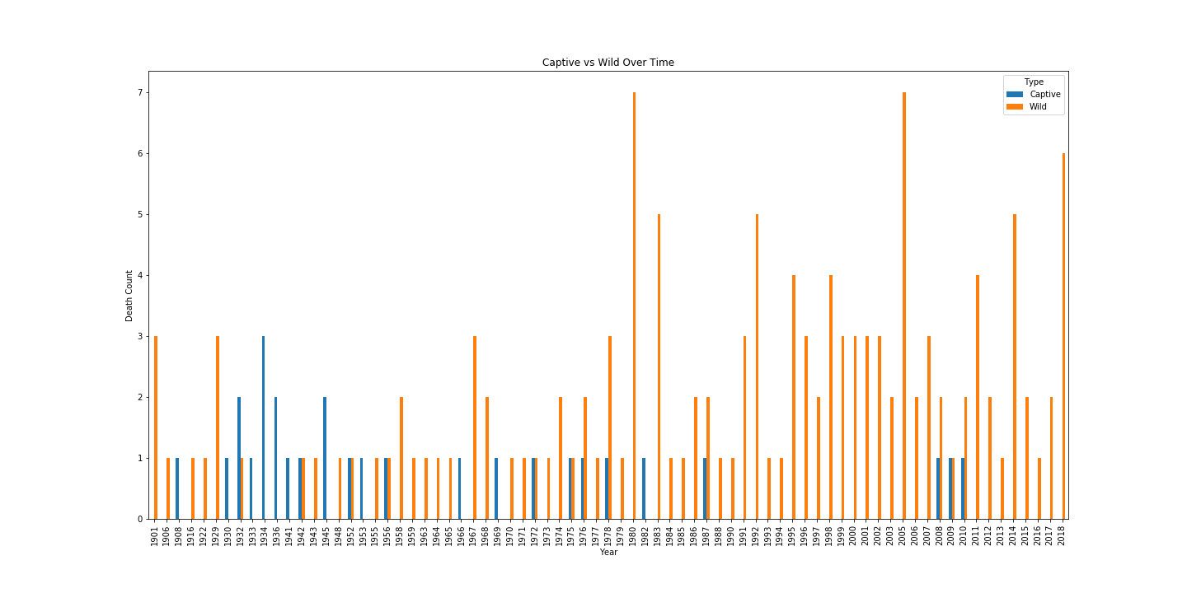
Reasons for the increase?
Notes:
More people
More transportation
Better tracking/ capturing data
General rise in fascination of wilderness/outdoors

Slide 11
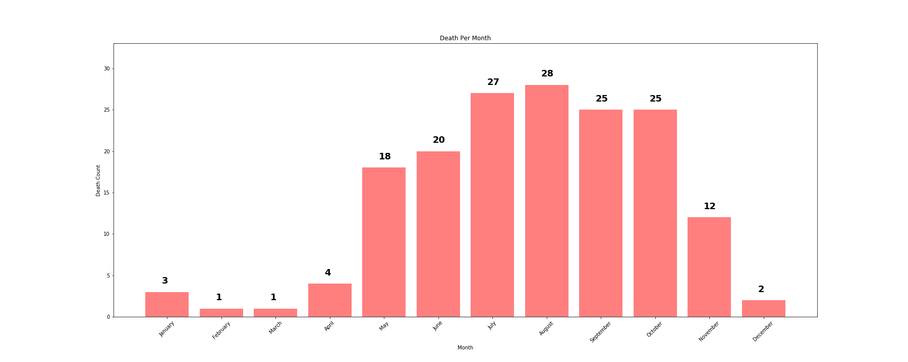
Seasonal Killings

Slide 12
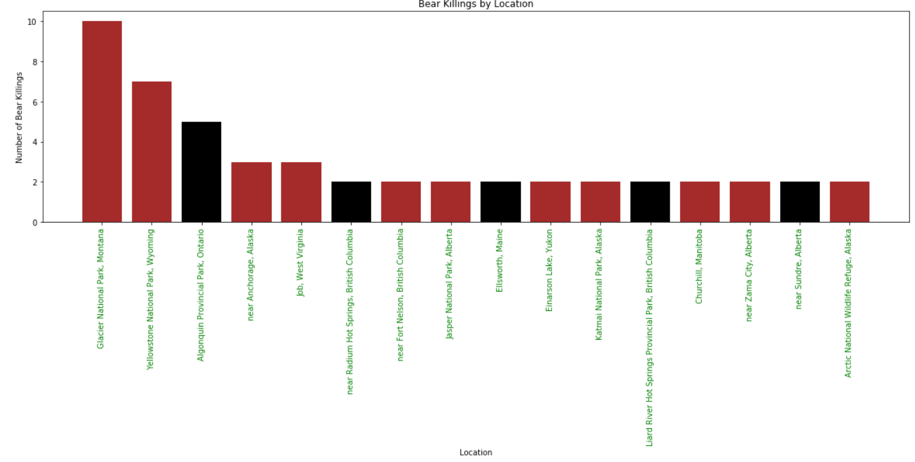
Analysis : Where do they occur?

Slide 13
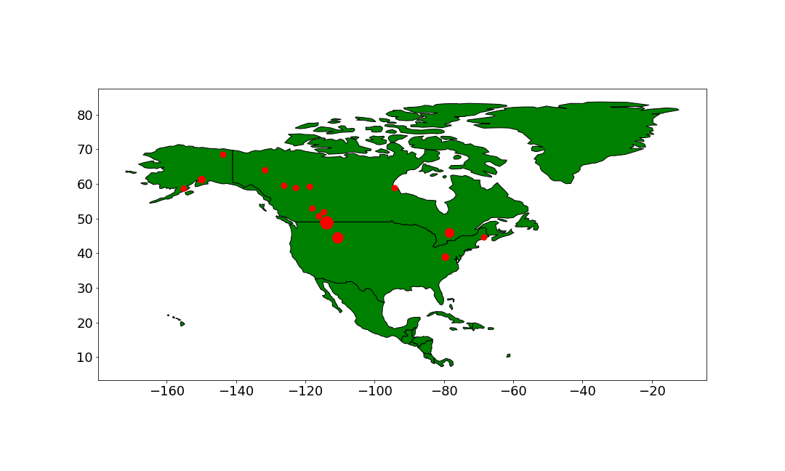
Analysis : Where do they occur?
Obstacle: Generate a map for locations with two or more killings
Solution: Generate location coordinates in gmaps, then insert coordinates into DataFrame as columns to generate map using geopandas

Slide 14
Thank you! Any Questions?
A Message from BearSmart.com:
Avoid bears (Well, duh...)
Have bear spray handy if planning to camp, hike, explore National Parks
If you see a bear in the distance, keep it that way and back away slowly (Do not run)
If approached, or attacked, by an aggressive bear, play dead (Until it starts eating you, then attack back. Good luck...)
If approached by a curious bear (non-aggressive), sound threatening, loud and make yourself look as big as possible

